Slide 1
Summer Internship 2017- iTransition Inc

Slide 2
Role
My internship at iTransition Inc. was of two-three, where I was asked to perform the role of a Project Manager.
My mentor/supervisor; Tanya Lukyaenko, herself a project manager gave me projects and new tasks everyday, which were really beneficial and it got me thinking as a project manager.

Slide 3
What did I do?
Through the course of my Internship, I was given number of tasks to practice my project management skills.
- Demonstrated solid understanding on project methodology and cooperation models.
- Found a solution to common project cases, i.e. scope management for a fixed budget project.
- Manage tough project cases
- Evaluate a scope of work for a future work project, based on information available through documentation.

Slide 4
Software used
Through the course of my internship, I used two main software tools, i.e. JIRA and Confluence.
Confluence was used in order for me to collaborate with my team, see the tasks I was assigned for the day and follow the internship plan.
JIRA was used in order for me my team and I to track all our agile, Kanban development and fix any bugs

Slide 5
Tasks Assigned
Some of the main tasks assigned during my internship included-
Creating a project Triangle, detail learning about project methodology i.e. , Scrum, Kanban, Agile, and Waterfall.
Communication- Team, Client
- I was asked to work on cases that my mentor and team have asked encountered in the past, including difficulties such as Overbudget, Deadlines not being met, Customer is unsatisfied with the quality of service, Customer’s vendors in place etc.
- My job was to show how will I handle, and manage the situation in what way.

Slide 6
Tasks Assigned
Some of the cases were as follows:
We had sprint planning today, Veronika was an hour late with no prior notice. Veronika left early without confirming coverage before she left. Valeriya dropped off the call saying the team would estimate all tasks during Tuesday and did not wait for confirmation that this plan was acceptable. We are now trying to finish the remaining hour of sprint planning with no QA representation. Please send me the profiles of QA testers who we can review to replace one or more of our current team.
You are a project manager. You have got a fixed-budget project. When it's just started, and the customer is trying to add more details to the requirements which makes it more complex to implement and requires more time that has been estimated.

Slide 7
Tasks Assigned
Project Infrastructure- JIRA for tracking purpose of the project.
- Created my own dashboard name “JIRA Test” containing the following info:
.) All tasks assigned to me and created today
.) All bugs assigned to you divided by priority and status (so we can see how many defects of each priority you have in each status)
.) Pie chart showing info on how many issues you have under each Epic
.) All bugs that have been reopened

Slide 8
Project
Our Customer- National Treasures Media
The client and us were working together to create a software that was supported by iOS, Android.
The launch date was projected to be end of September 2017, starting with first campaign in Germany and every following month, there will be another campaign in
As project mangers, our first step was to ask our client questions about the project, come up with estimations, WBS( work breakdown structure) and move on to the next step.

Slide 9
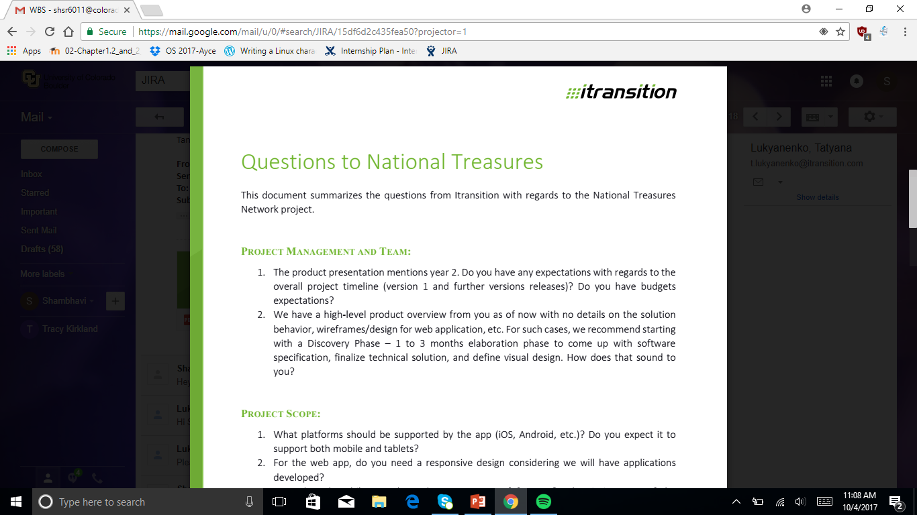
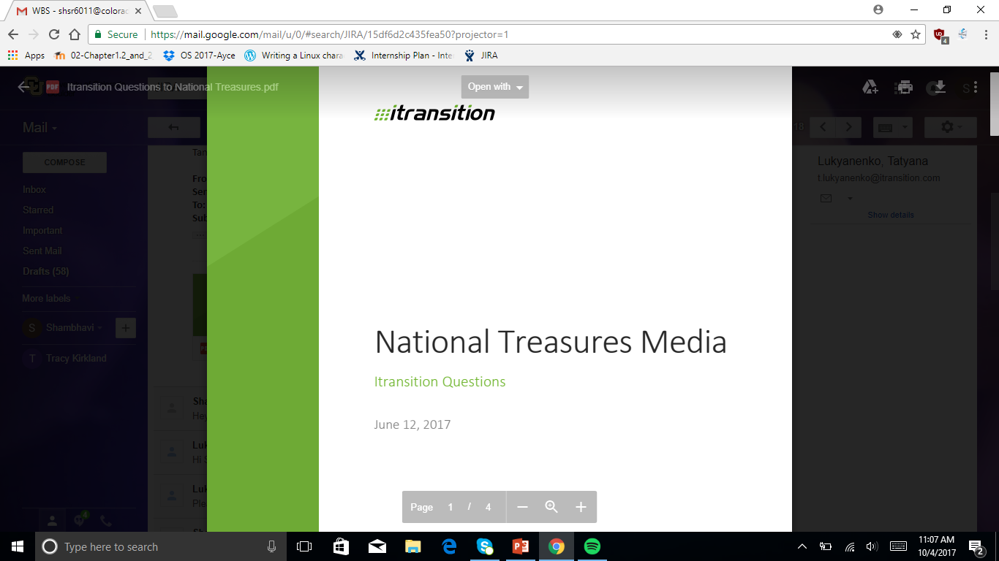
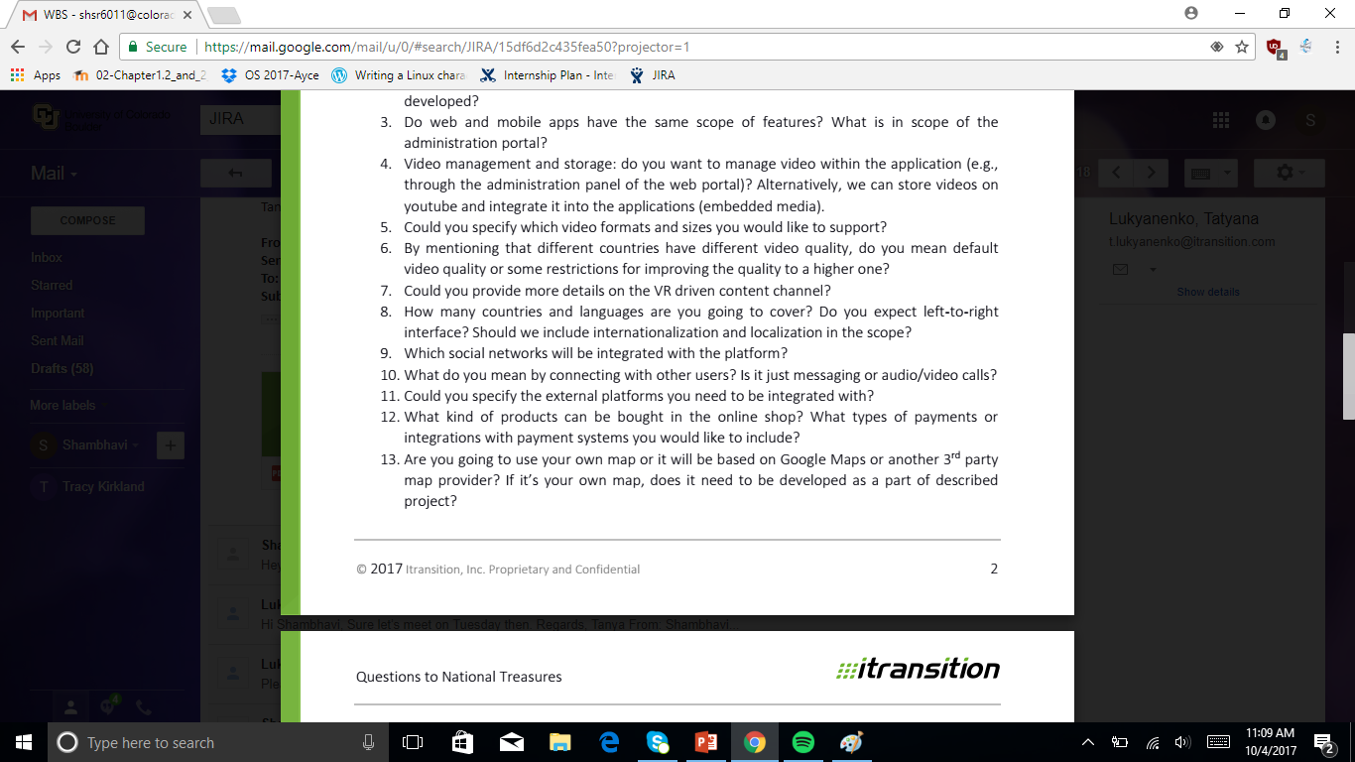
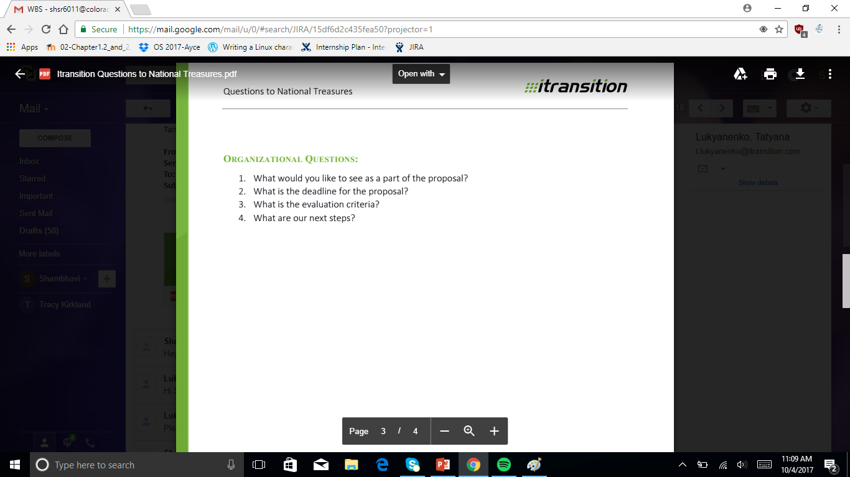
Here are a list of questions I came up with to ask our client.

Slide 10
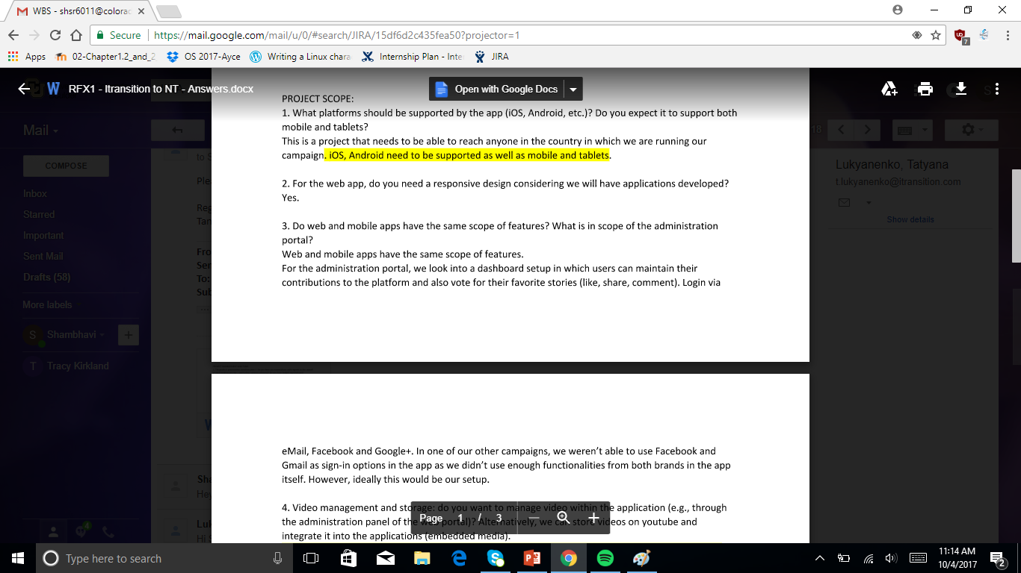
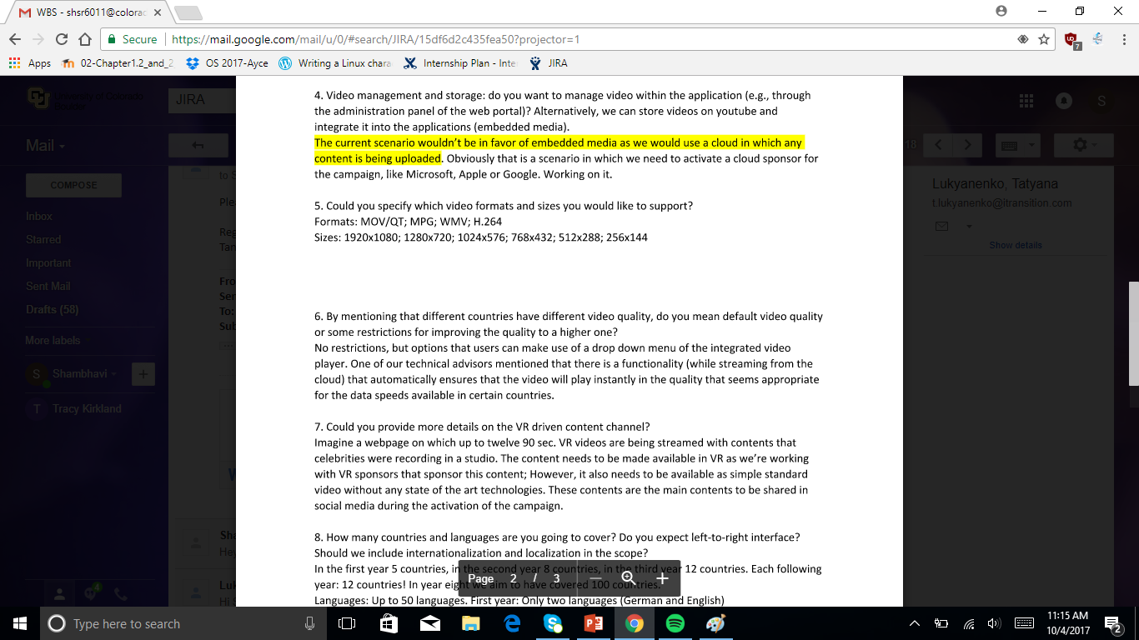
Project- Continued
Our client got back to us with the following answers, giving us a good lead in the project. Here are couple screenshots of the answers we received.

Slide 11
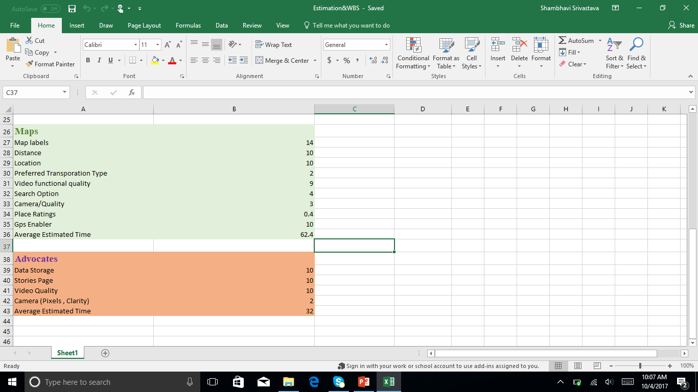
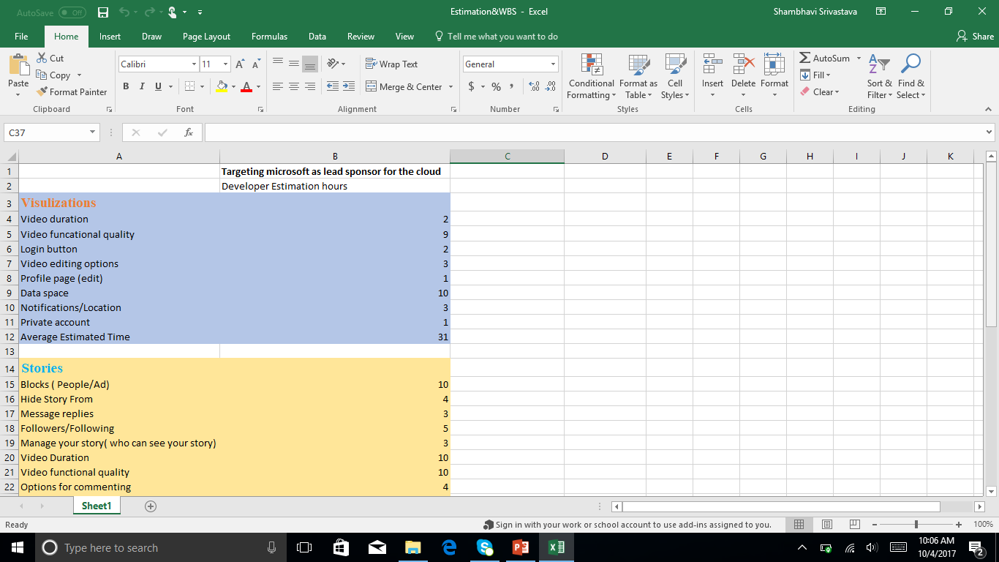
Project Continued
We were then asked to create a rough estimation/Work Breakdown Structure about how many hours developers are going to require to create features based on the information we were given. Here are couple screenshots of the estimation.

Slide 12
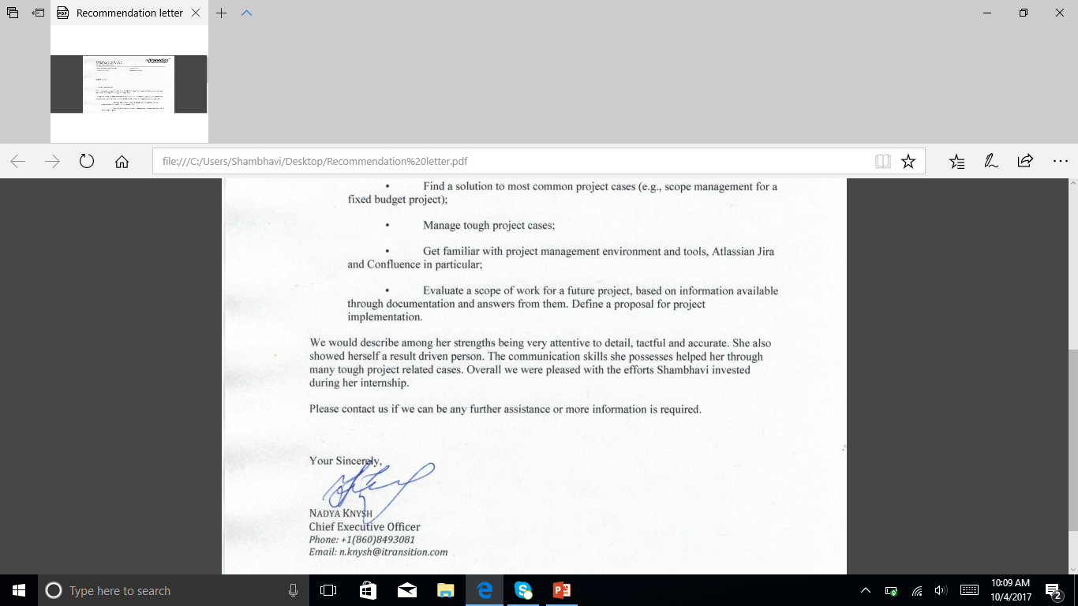
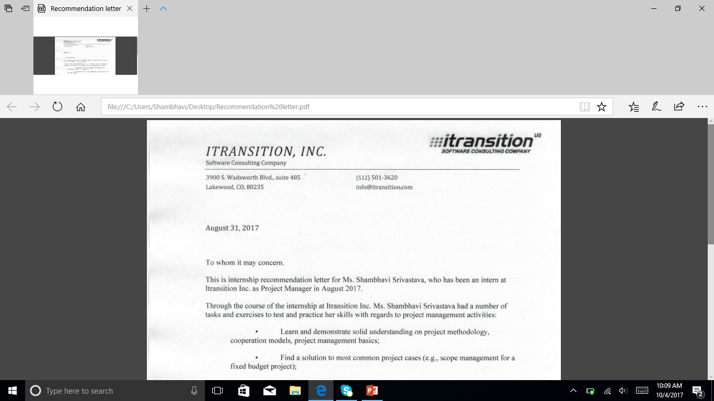
Recommendation Letter
I thoroughly enjoyed my internship because of the work, and the hands on project management experience I got.
My manger and mentor was kind enough to give me a recommendation letter.

Slide 13
Recommedation letter

